Slide 1
Simulations with Mack’s Power Data from Oct 25
On IEEE 123-Bus Test Feeder
2-MW PV

Slide 2
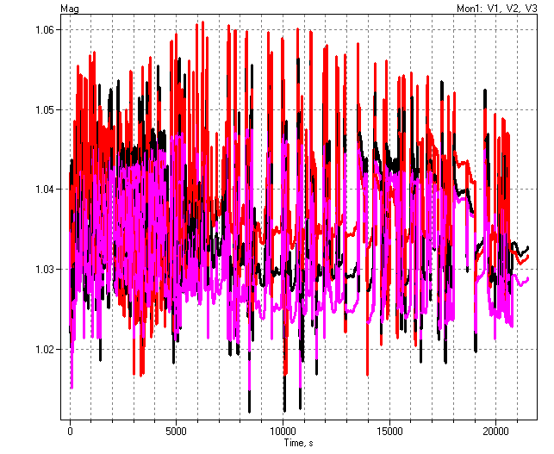
Voltages

Slide 3
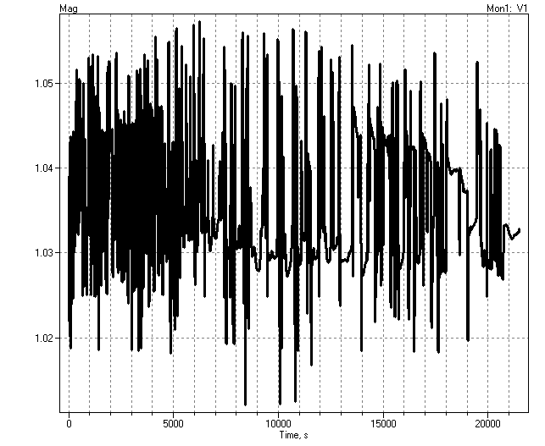
Phase A Voltage

Slide 4
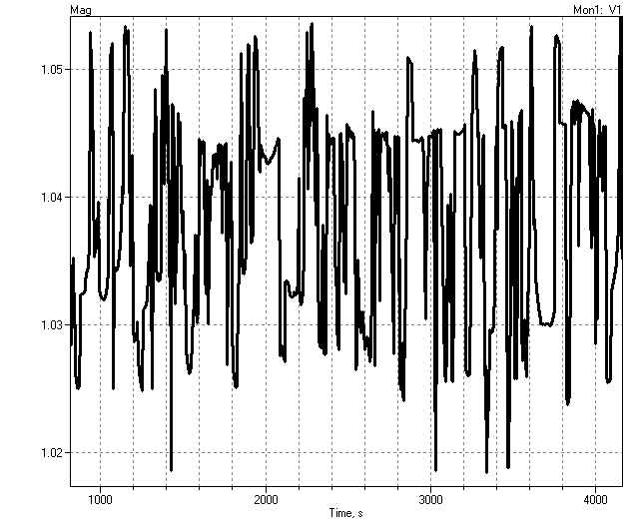
Phase A Expanded

Slide 5
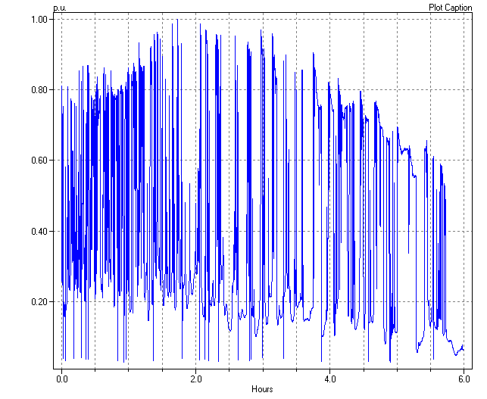
LoadShape

Slide 6
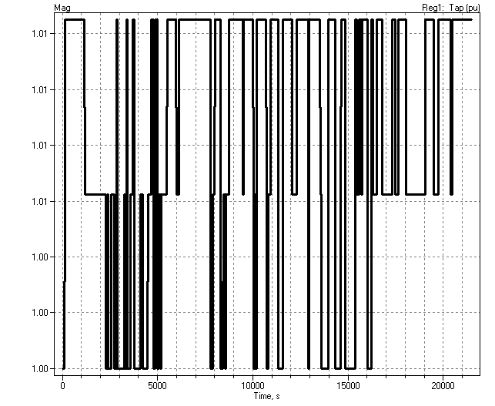
Regulator Taps

